Slide 1

EncAPSULATION

Slide 2
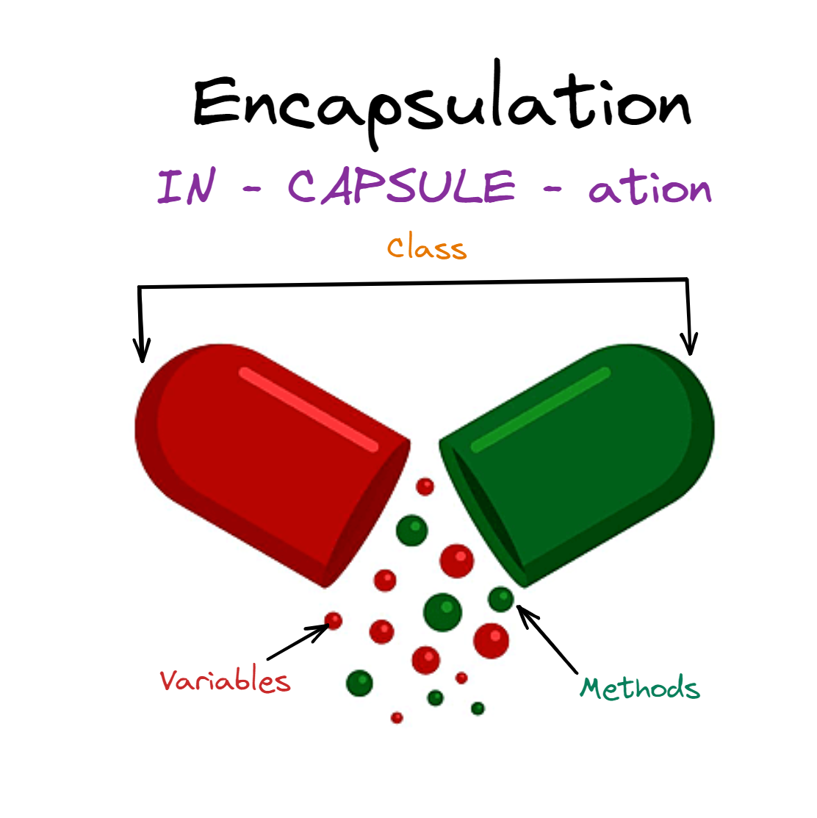
WHAT IS ENCAPSULATION
Encapsulation is one of the core principles of object-oriented programming (OOP). It means bundling related data (attributes) and methods (functions) into a single unit, like a class, and restricting access to some of the class’s internal details to protect data integrity.

Slide 3
IMPORTANCE
It provides a way to store, hide and manipulate data
Simplifies code maintenance
Provides data protection

Slide 4
Example of Encapsulation
class Bank
{
public long AccountNumber;
public string Name;
public int Balance;
public void GetBalance()
{
}
public void WithdrawAmount()
{
}
public void Deposit()
{
}
}
}
class Program
{
static void Main(string[] args)
{
Bank bank = new Bank();
bank.AccountNumber = 12345678;
bank.Name = "Pranata";
bank.GetBalance();
bank.WithdrawAmount();
}
}

Slide 5
HOW TO ACHIEVE
Data Encapsulation in C# is implemented by using the Access Specifiers.
Access specifier defines the scope and visibility of the class member.
Types in C#:
Public-The public members can be accessed by any other code in the same assembly or another assembly that references it.
Private-The private members can be accessed only by code in the same class.
Protected-The protected Members in C# are available within the same class as well as to the classes that are derived from that class.
Internal-The internal members can be accessed by any code in the same assembly but not from another assembly.

